Slide 1
Key Metrics Identification

Slide 2
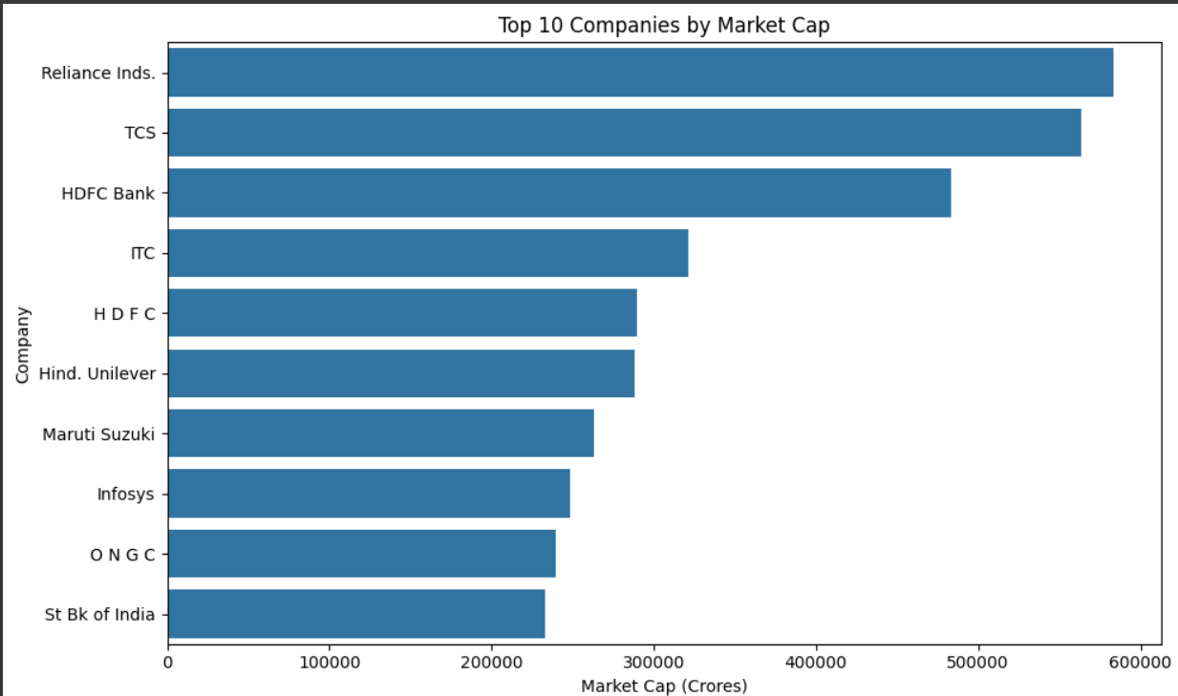
Top Companies by Market Cap Content:

Slide 3
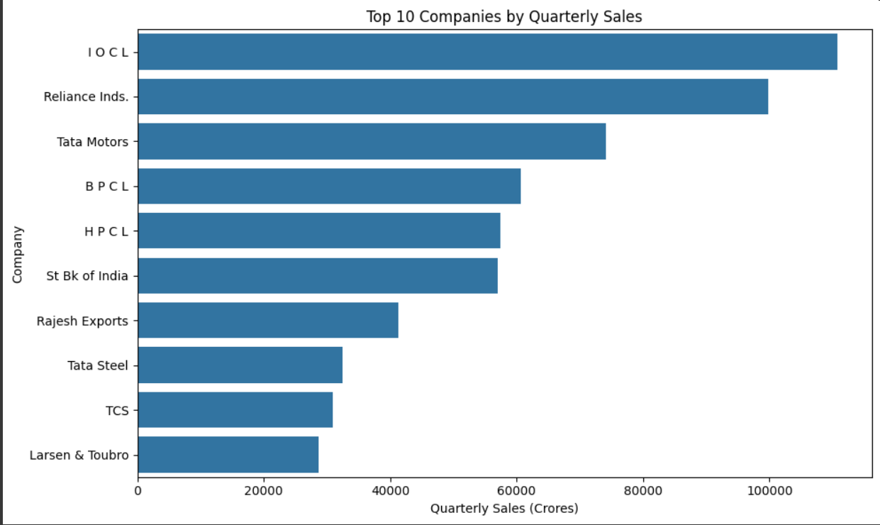
Top Companies by Quarterly Sales

Slide 4
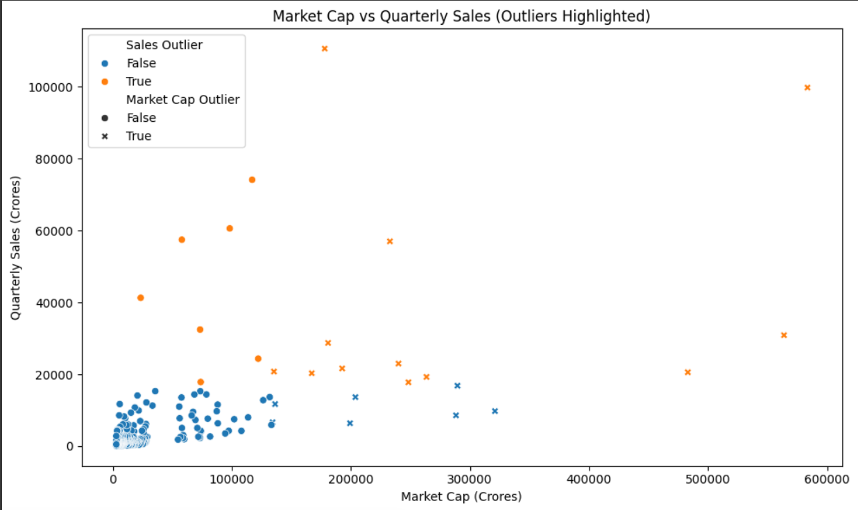
Market Cap vs Quarterly Sales (Outliers Highlighted)

Slide 5
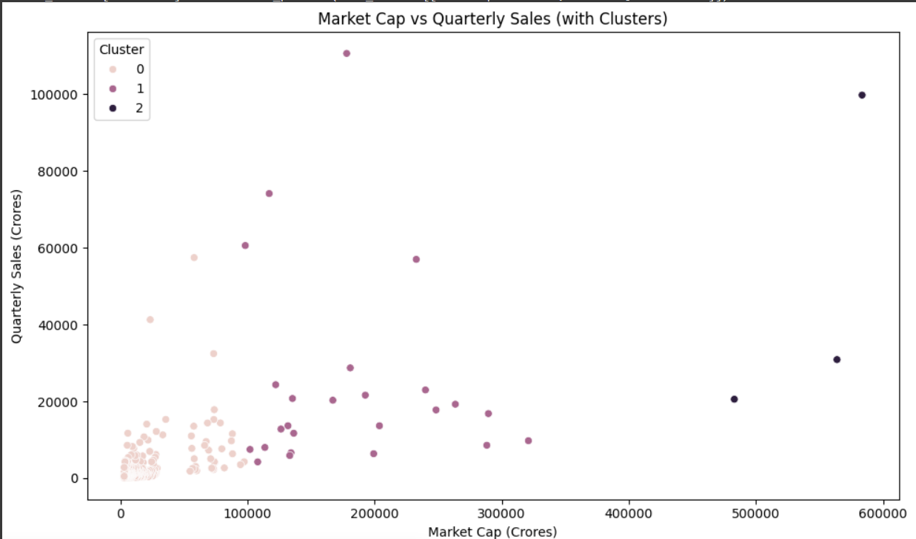
Clustering Analysis

Slide 6
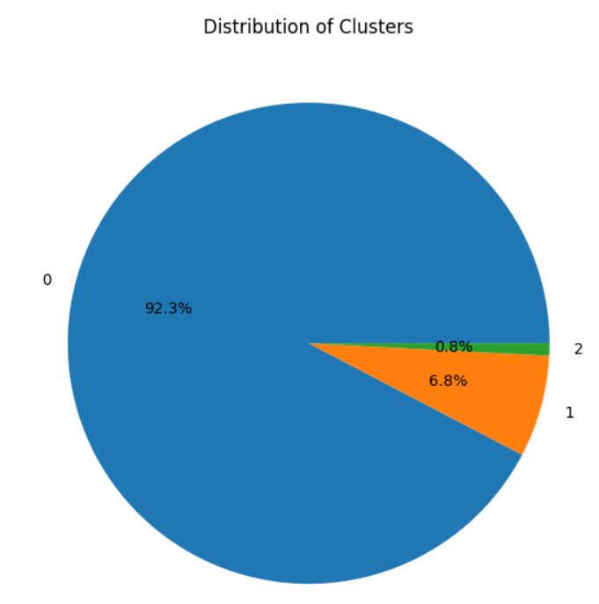
Distribution of Clusters

Slide 7
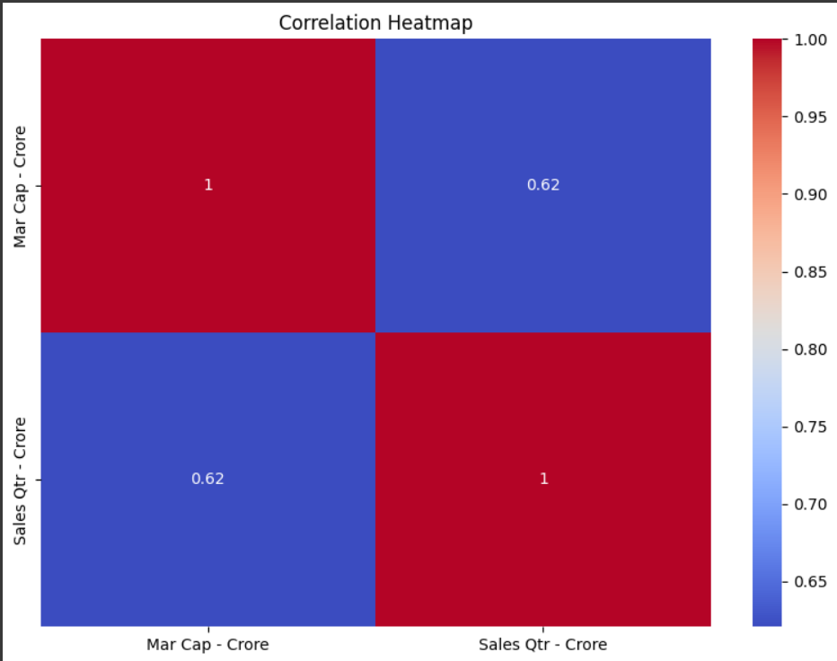
Correlation Analysis

